Slide 1

Building and Deploying a .NET 9 App Using Azure, Bicep, and GitHub Actions
Scott Sauber
Director of Engineering
Lean TECHniques
Level: Introductory
Notes:
Open AzureAdmin app
Start collecting GH usernames and emails
Remember to add their Service Principal for Dev + Prod with Federated Credentials first and then run the AzureAdmin app
Open WorkshopDemo
Leave email open that I sent to myself
Copy workshop-dotnet-azure-github-bicep and sp-workshop-scottsauber-dev to your clipboard

Slide 2
What you need
.NET 9
An Editor that supports .NET 9 and Bicep
Visual Studio 2022 Latest
Visual Studio Code (Bicep extension)
Fork this repo:
https://github.com/scottsauber/workshop-dotnet-azure-github-bicep
Slides in root under Slides.pdf
Download the Azure CLI
Azure will be provided for free
Please let Scott know the following if you’re participating:
Email you will use for Azure
Your GitHub username

Slide 3
What we all need
Azure to not go down
GitHub to not go down
GitHub Actions to not go down
The conference internet to not go down
🙏🙏🙏
(I do have recordings if needed but that’s no fun)

Slide 4
Audience
Anyone interested in Azure, GitHub, or Bicep
.NET Developers
People interested in DevOps but never got to do it
Already know Git
If you have questions, ask them! If no one but me talks this is gonna be boring

Slide 5
Poll
How many .NET Developers in the room?
How many have used Azure?
How many have used Bicep?
How many have used GitHub Actions?
Why are you here? What do you want to learn?

Slide 6
Agenda
What is the final state of what we’re building?
What is Azure?
What is Azure App Service? Plans?
What is Bicep?
What are GitHub Actions?
Health Checks
Azure Key Vault Integration
Azure Application Insights Integration
Hands on all throughout

Slide 7
Goals
Learn GitHub Actions, Bicep, and Azure
How they all integrate with a .NET app
The feedback loop on this can be slow – especially if you typo!
Take home a few things back to work, whether beginner or expert

Slide 8

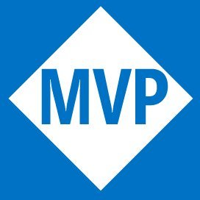


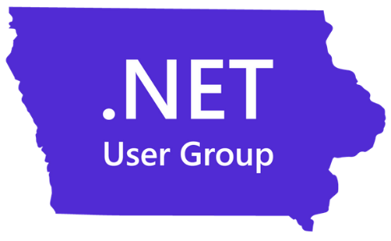
Who am I?
Director of Engineering at Lean TECHniques
Microsoft MVP
Dometrain author
Redgate Community Ambassador
Co-organizer of Iowa .NET User Group

Slide 9
What are we building?
.NET 9 API
Running on Azure App Service
Configured using Infrastructure as Code with Bicep
Deployed using a CI/CD Pipeline via GitHub Actions

Slide 10
Features of what we’re building
Zero Downtime Deployments
Infrastructure managed by code, not clicking in the Azure Portal
Automated Build and Deploys
Follows Azure Naming Standards
Versioning your app so you know what’s deployed
Health Checks
Secrets in Key Vault, not Source Control
Observability using Application Insights

Slide 11
Why is this important?
https://dora.dev/
DORA
Continuous Delivery, Deployment Automation, Flexible Infrastructure, Continuous Integration, Version Control, Monitoring/Observability are all listed as 6 of the 18 capabilities listed for high performing teams.
We will touch on all of these today

Slide 12
Why is this important?
https://dora.dev/
DORA
Continuous Delivery, Deployment Automation, Flexible Infrastructure, Continuous Integration, Version Control, Monitoring/Observability are all listed as 6 of the 18 capabilities listed for high performing teams.
We will touch on all of these today

Slide 13
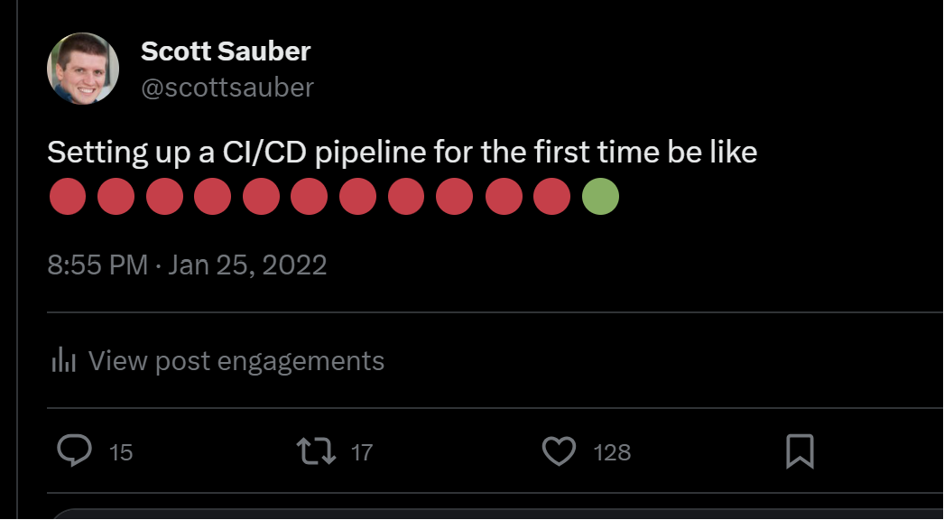

Slide 14
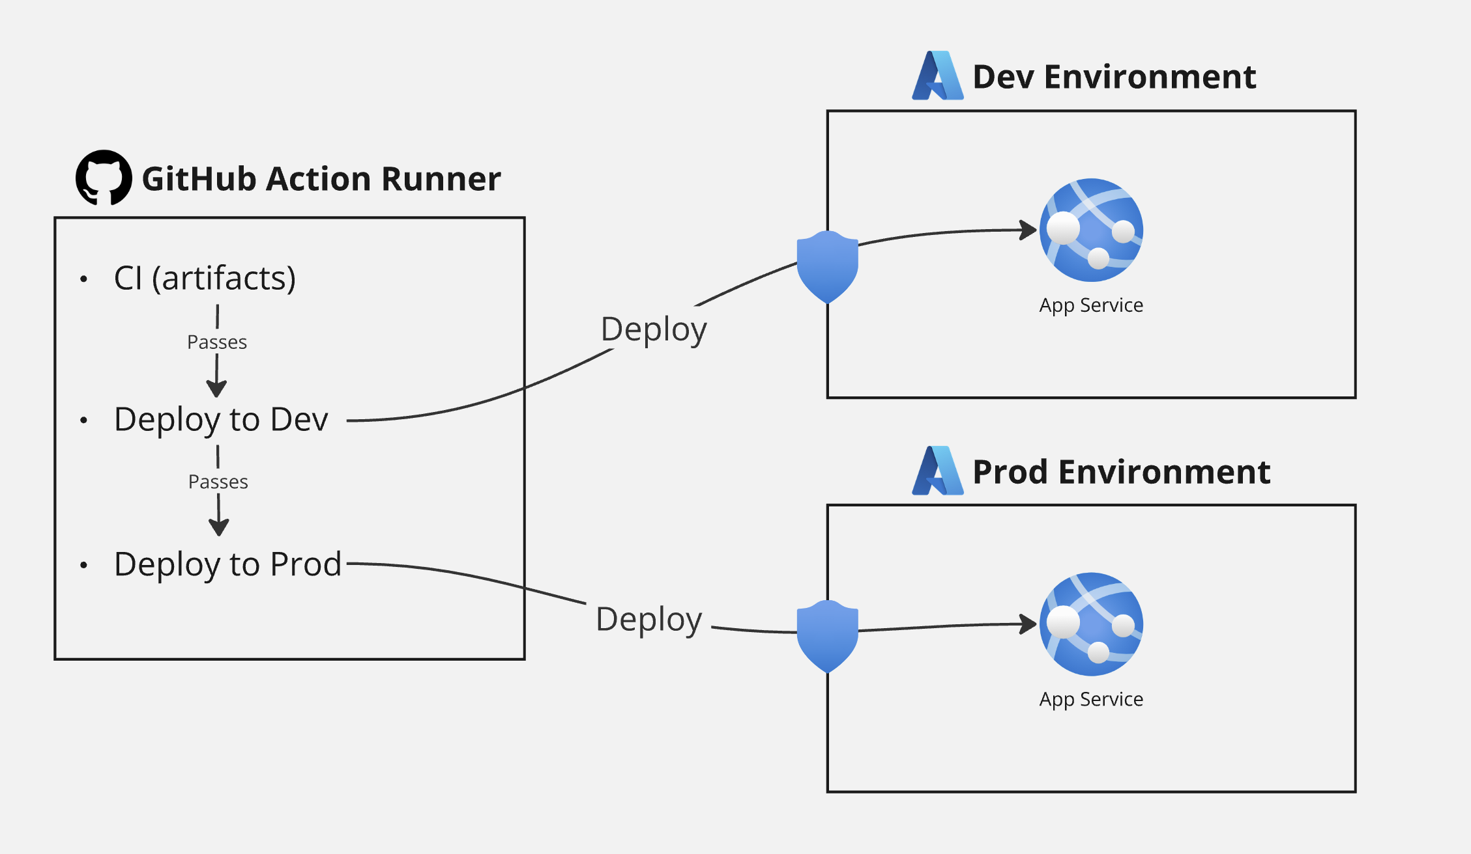

Slide 15

Azure

Slide 16
What is Azure?
Microsoft offering for cloud hosting
Offers many services from hosting web apps to databases to caching to messaging to…
You should probably be picking PaaS offerings (i.e. not VMs)

Slide 17
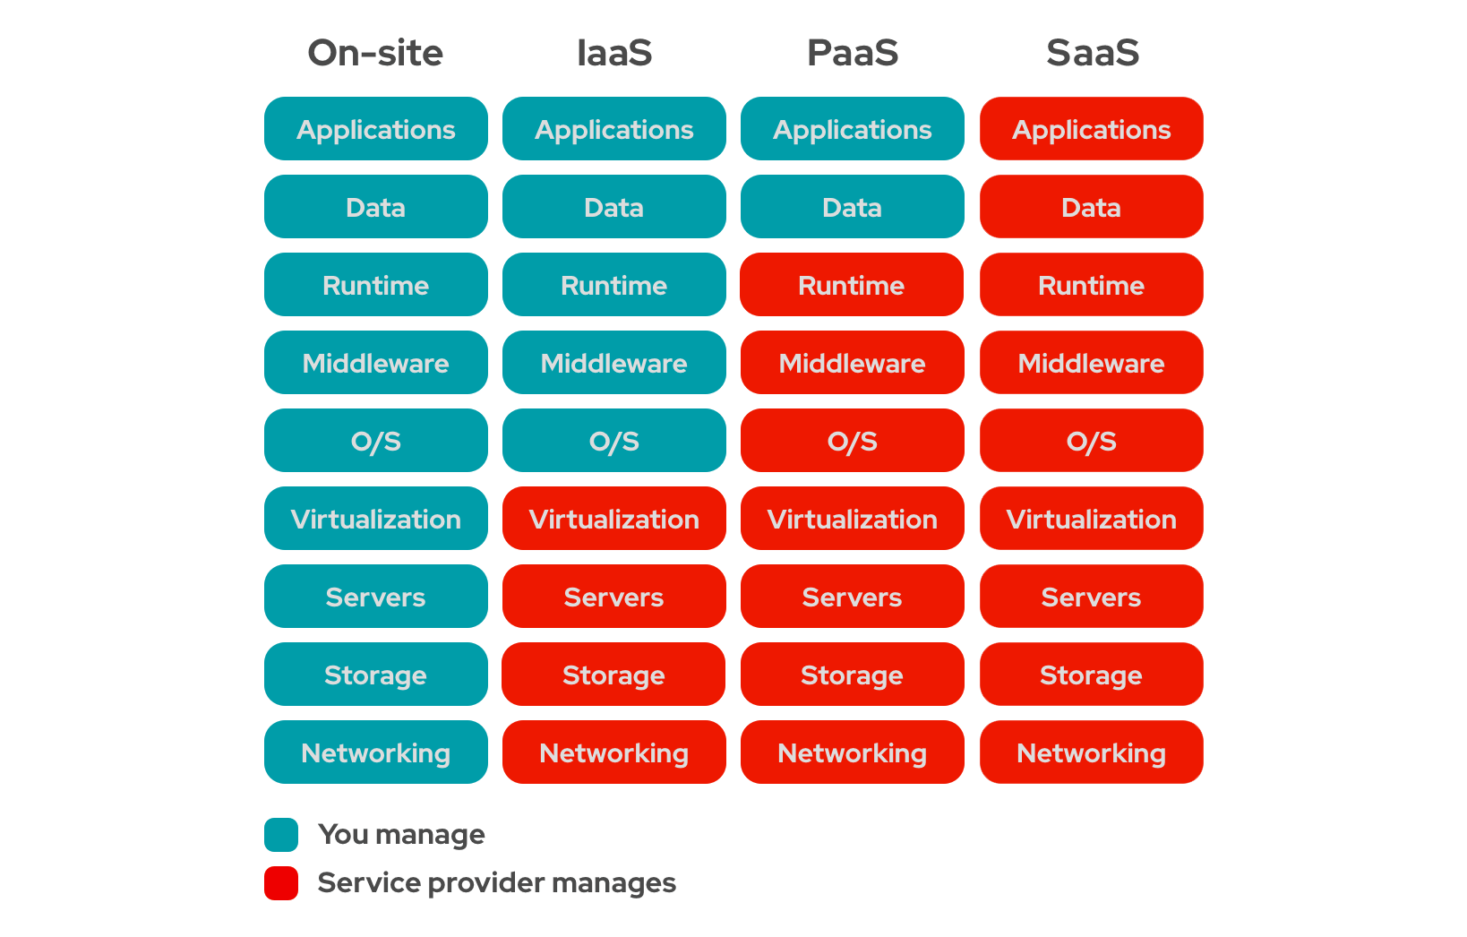

Slide 18
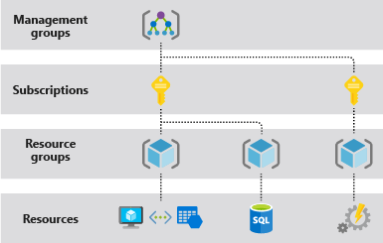

Slide 19
Subscriptions
Top-ish level organization (ignoring Tenants, Management Groups)
Recommended per team per env
Naming convention: sub-<team>-<env>
Ex: sub-accounting-dev
Role access separation
Billing separation

Slide 20
Resource Groups
Related groups of resources (ie web, db, key vault, etc)
Quickly view all resources related to app
RG = folder, Resources = files
Recommended per app per env
Naming convention: rg-<product>-<env>
Example: rg-fancyapp-dev
May have many RG’s in 1 subscription
Role access separation
Billing separation

Slide 22
Questions?

Slide 23

Azure App Service

Slide 24
App Service
PaaS offering for hosting applications
✅Handles OS patches, Framework patches
✅Zero downtime deployments via Slots
✅SSL Certs
✅Custom domains
✅Autoscaling
✅Very simple
✅And more
❌Less control because PaaS

Slide 25
App Service Plan
Kinda like VM for your App Service(s)
Pick how much memory, storage, CPU
Multiple app service on one ASP (should you?)
Many apps can get away with P0V3 ($62/mo for Linux)
Need to be at least Standard to get Slots

Slide 26
$ an issue?
Savings Plan – commit to $ amount
Save 25% 1 yr, 45% 3 yrs
Reservation – commit to compute tier
Save 35% 1 yr, 55% 3 yrs

Slide 27
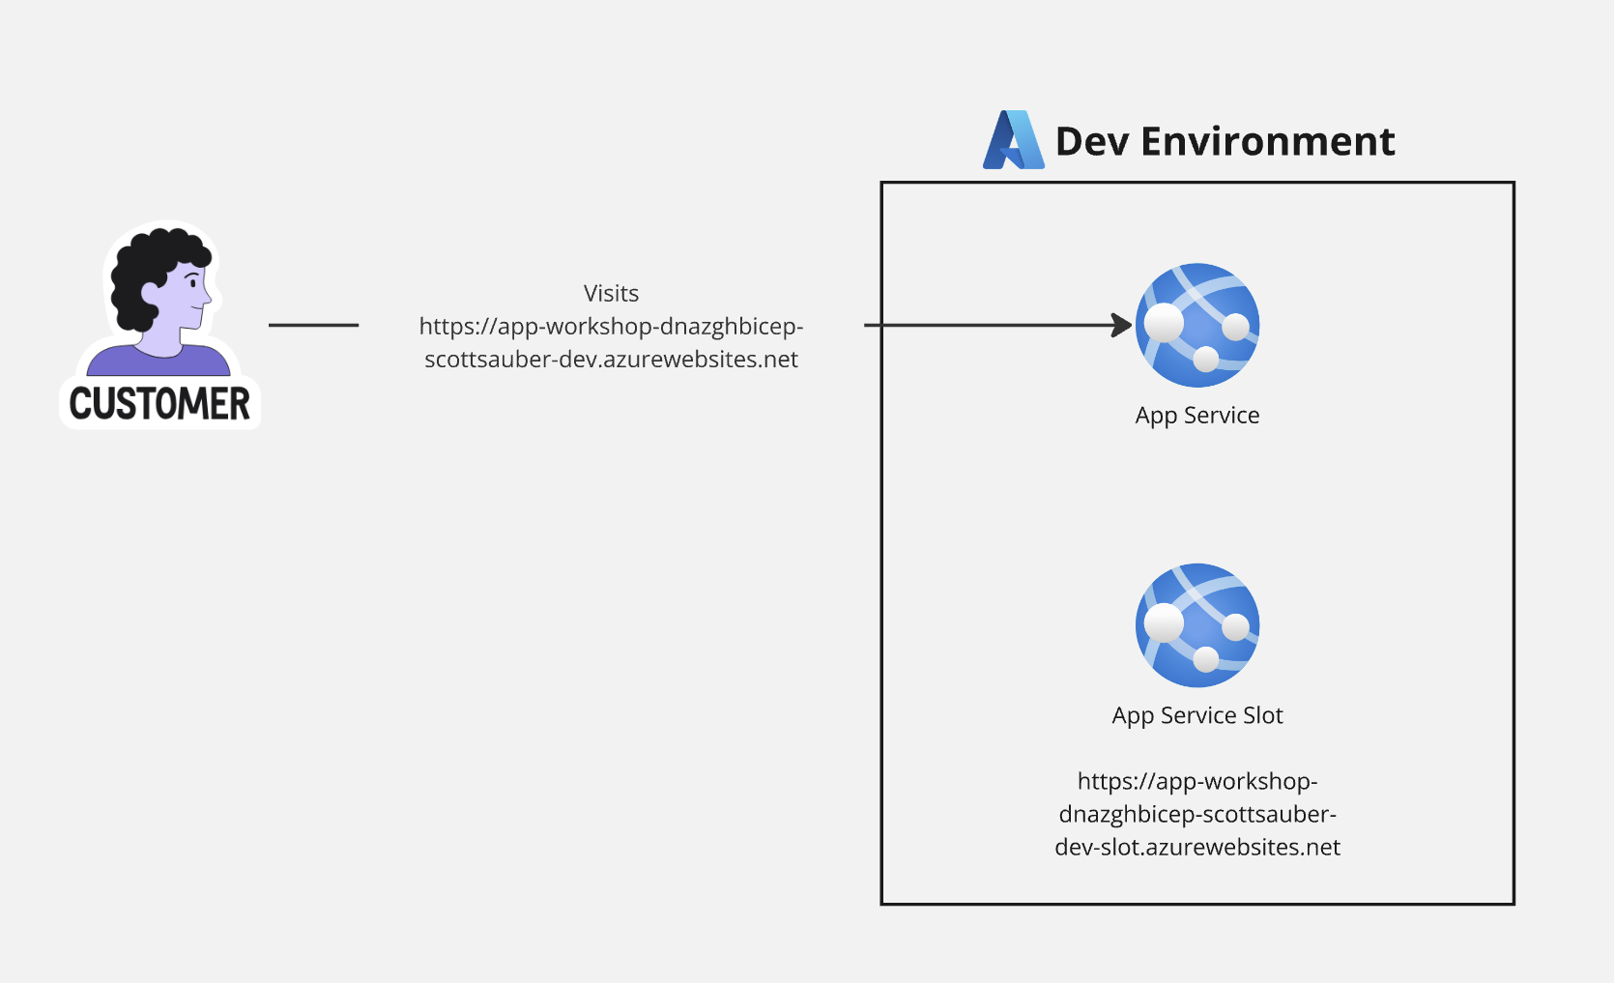

Slide 28
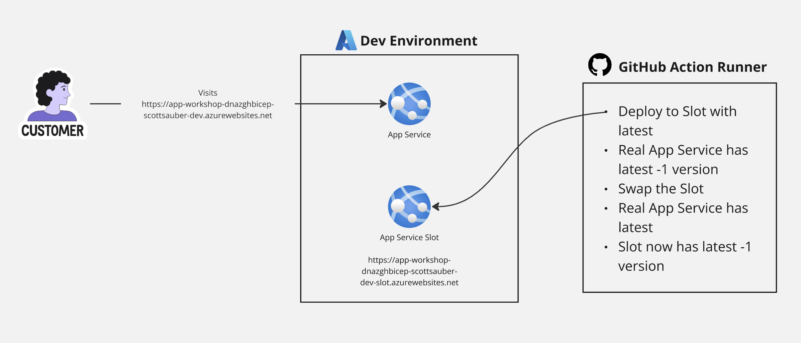

Slide 29
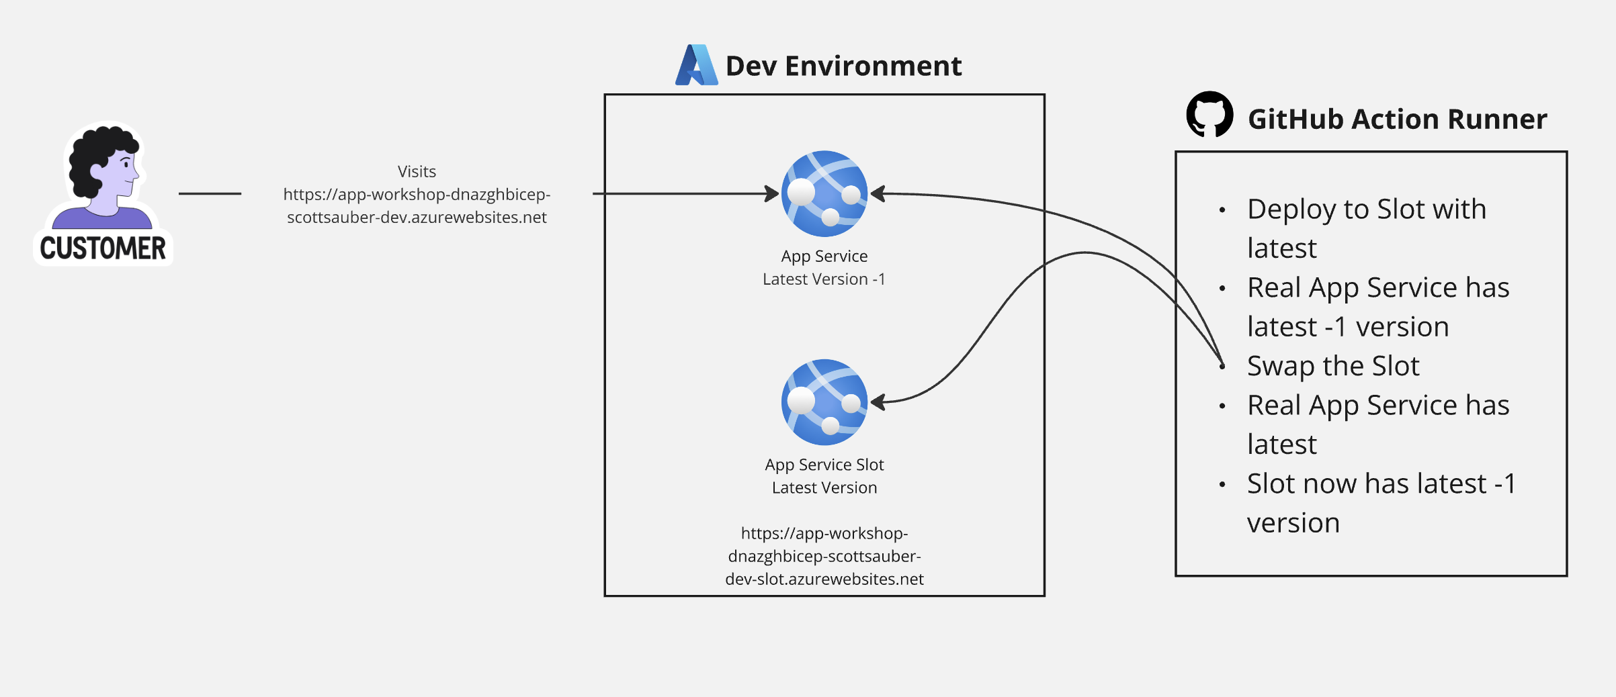

Slide 30
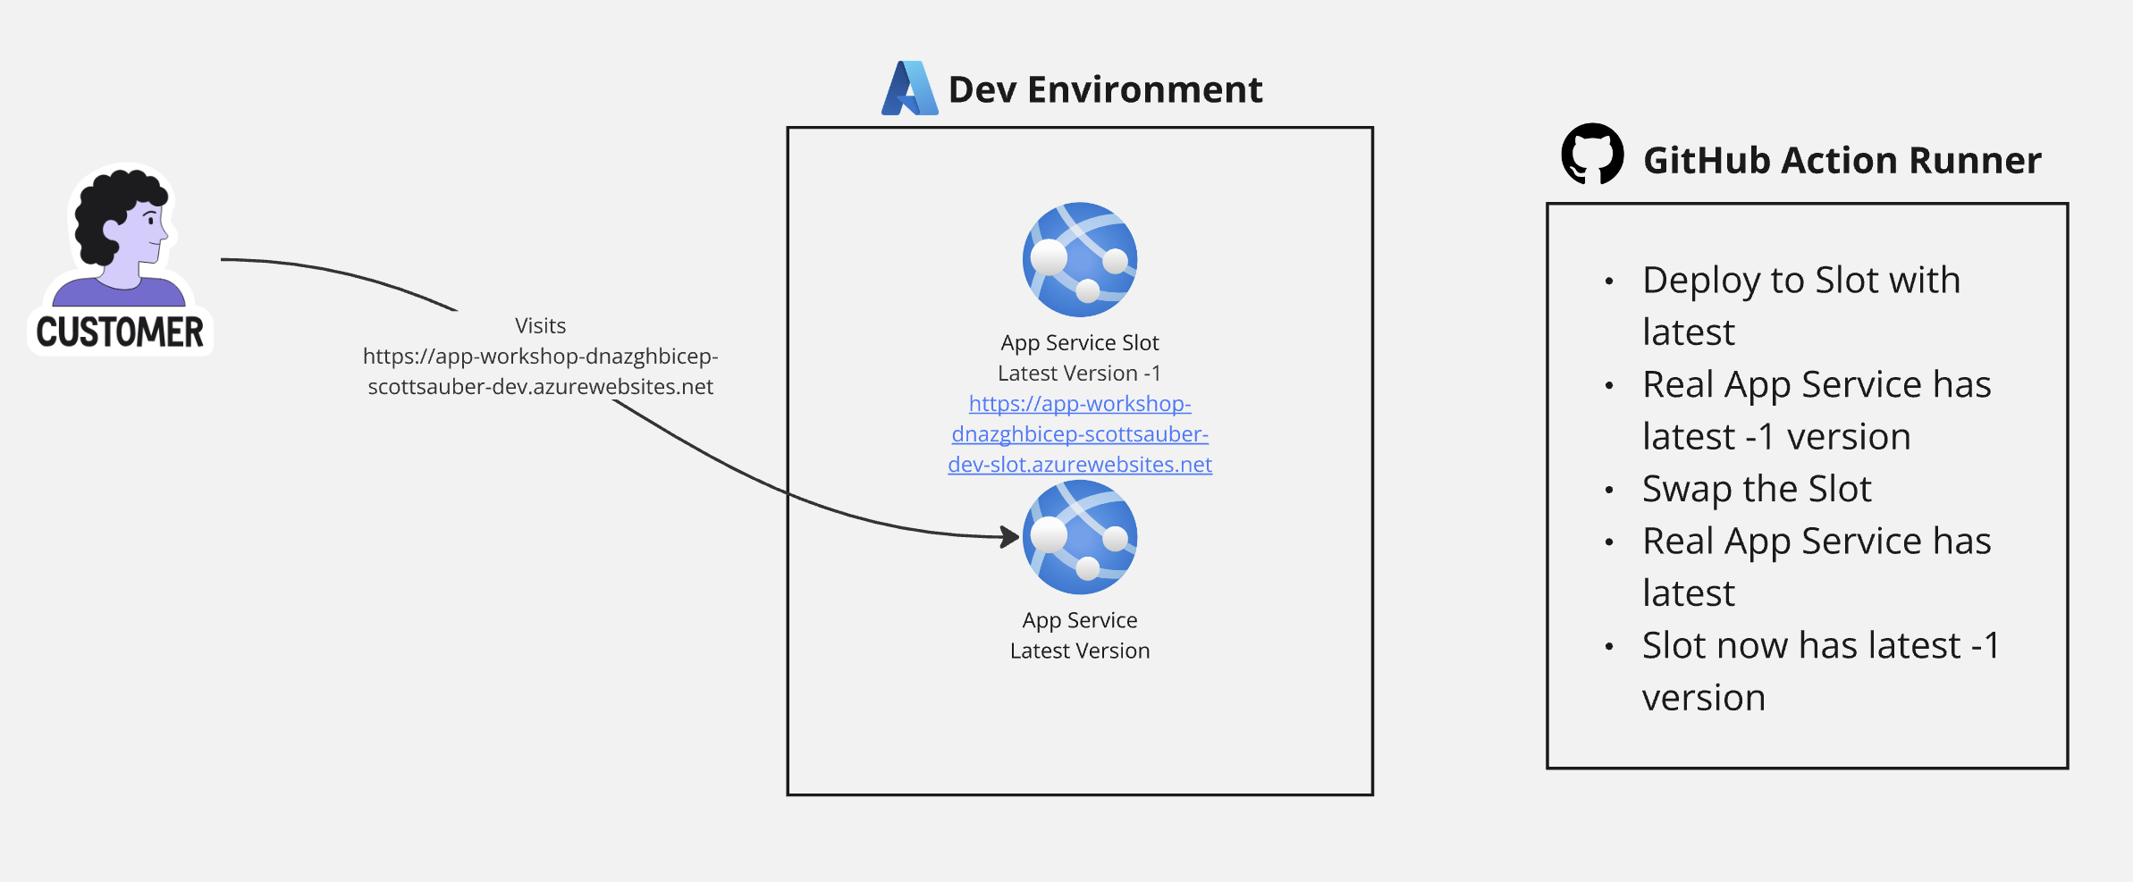

Slide 31
Live Demo
Notes:
- app service plan in relation to app services
- PaaS nature and all that it handles (server patches, OS patches, Certs, custom domains, etc)
- Env vars
- what slots are
- Kudu is a thing that exists and why it’s useful
- Log stream for really bad stuff going down bc ideally you’re using AppInsights or Log Analytics
- Export template
The app running at a URL
Click on it and go to /api/weatherforecast and /api/weatherforecast/slow

Slide 32
Questions?

Slide 33

Bicep

Slide 34
Infrastructure as Code (IAC)
Source code defining what resources to provision
Stored in version control
Declarative – what resources to create, not how to create them
Deployed via pipeline
Need a new env? Few lines of code

Slide 35
Without IAC
Clickety Clack Configuration™️
Repeat yourself for each environment
“It worked in Dev/UAT/Staging, not Prod”
“It works on my machine”

Slide 36
What is Azure Bicep?
Used to configure Azure resources
Built and maintained by Microsoft
Domain-specific language (fancy word for custom)

Slide 37
What is Azure Bicep?
Provides intellisense, error checking, “whatif,” and orders the resource creations
Built on top of Azure Resource Manager (ARM) – don’t use ARM directly
Can compose multiple files into “modules”
Can pass data between modules via outputs
No state file

Slide 38
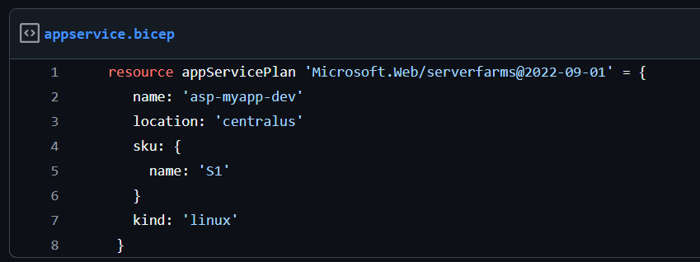
What is Azure Bicep?

Slide 39
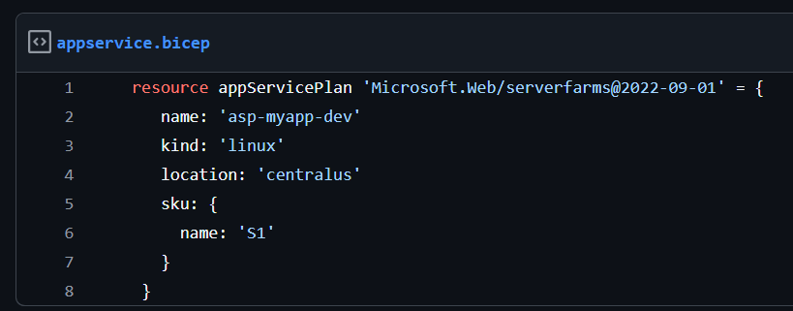
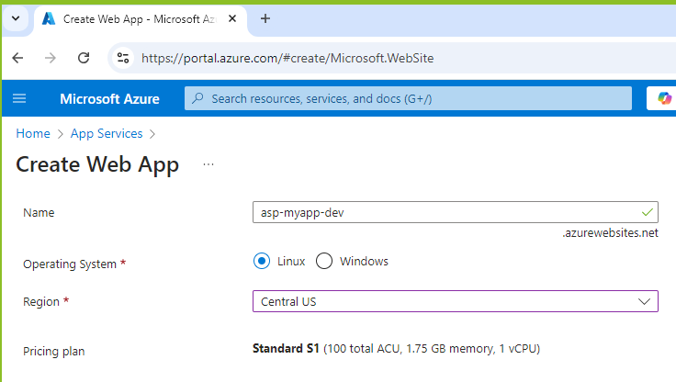

Slide 40
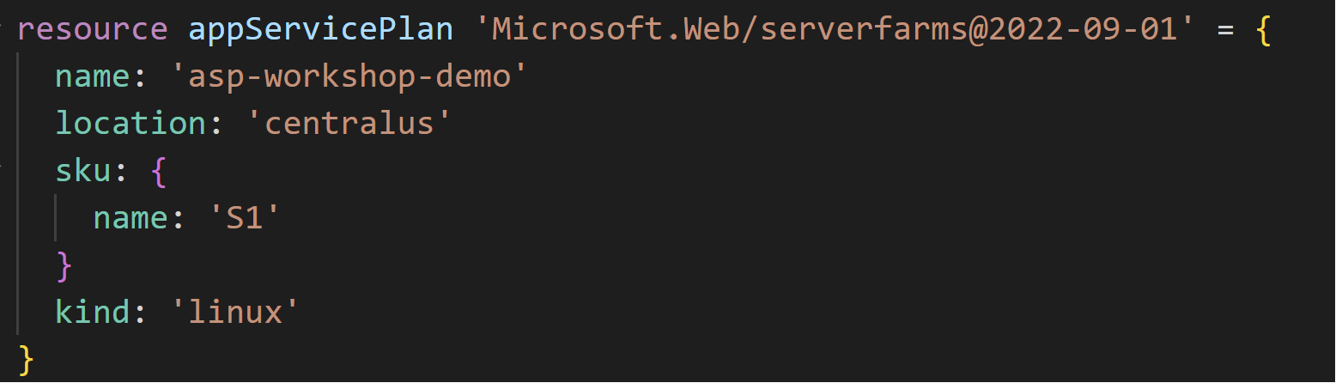
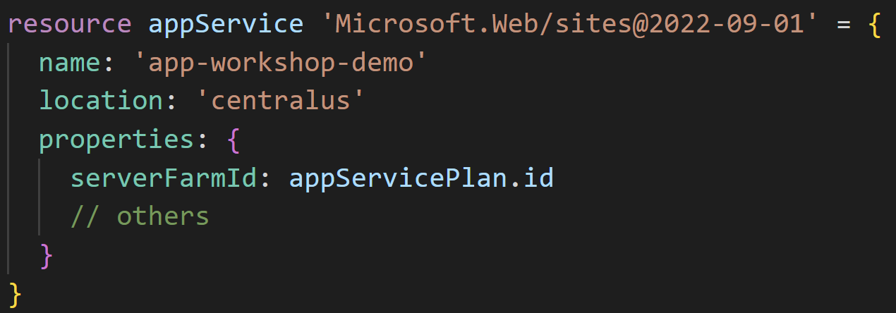
Notes:
Now we can reference resources from one another
This also tells Bicep – create the App Service Plan first before creating the App Service

Slide 41
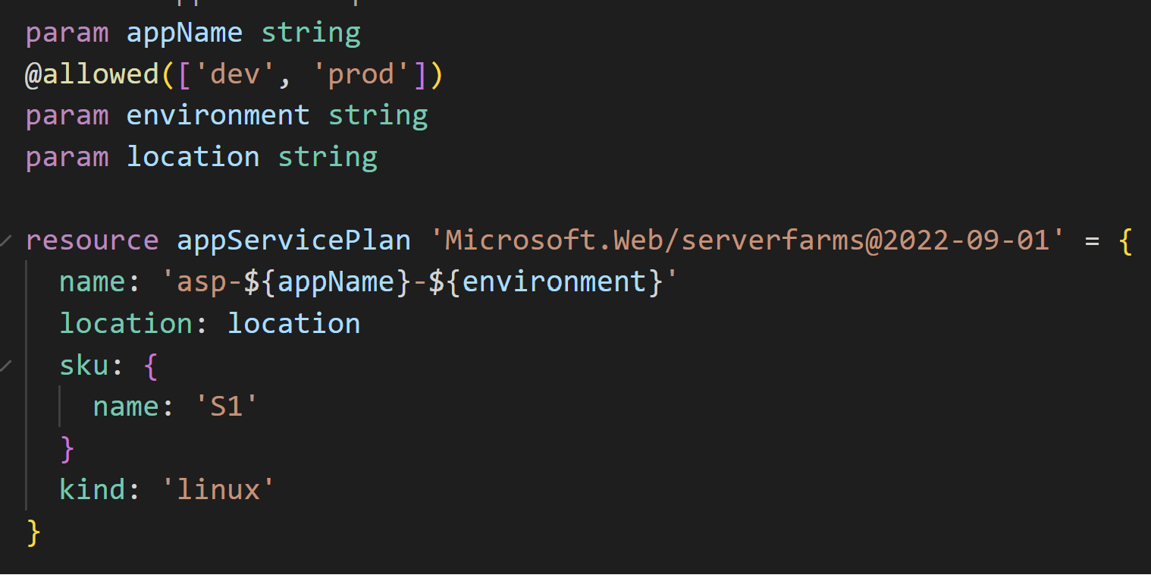
Notes:
Problem with the previous example is those names are hardcoded right. But we probably want like a Dev + Prod name
But how do we create this name dynamically?
Enter Parameter

Slide 42
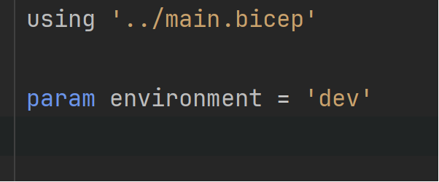
dev.biccepparam file
Notes:
You can store all your Dev values together in a single file
The using tells it what parameters are required and even works with the @allowed value

Slide 43
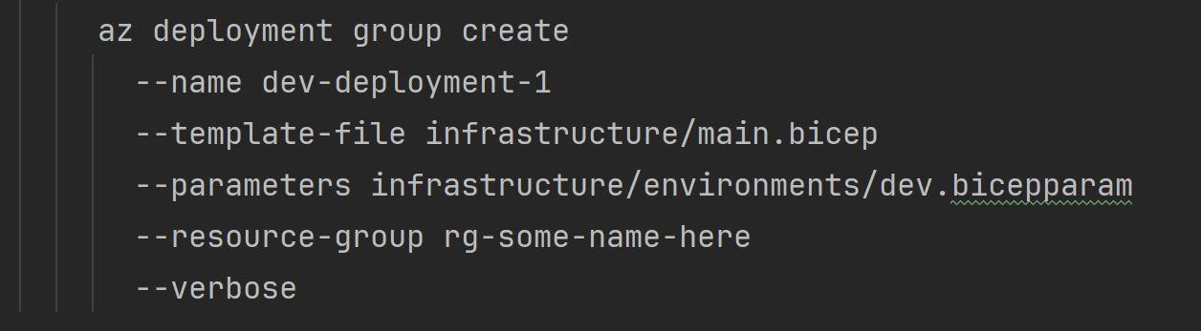
But how do I deploy it?

Slide 44
Key Concepts – Quiz time!
Resources
Modules
Parameters
.bicepparam
Outputs
--whatif

Slide 45
Benefits
No manual work of configuring in the portal (and repeating for each env)
Eliminate configuration drift
Traceability of who, did what, and when
Give Contributor access to the pipeline – not to individuals
No more “it works in Dev, not Prod” bc they’re the same!

Slide 46
Additional Resources
Documentation for various Bicep resources:
https://learn.microsoft.com/en-us/azure/templates/microsoft.web/sites?pivots=deployment-language-bicep

Slide 47
Live Demo
Notes:
VS Code
Show the bicepparam files
Show referencing the code from one another

Slide 48
Questions?

Slide 49
First Hands On Lab coming up… …how do you want to run these? 1. I give you time to do alone then move on 2. We “Do It Live™️” together

Slide 50
Break then Hands On for 40 minutes Module 4: https://github.com/scottsauber/workshop-dotnet-azure-github-bicep

Slide 51

CI/CD Pipelines

Slide 52
Continuous Integration
Automated verification of your application that generates artifacts
Compiles the app
Runs the tests
Independent witness - eliminates “works on my machine”

Slide 53
Continuous Delivery
Takes the artifacts from CI and deploys them automatically
Doesn’t deploy all the way to Production
Deploying to Production is a button click

Slide 54
Continuous Deployment
Deploys all the way to Production automatically
If the pipeline is green, it’s going to Production

Slide 55
Confident Green
If our build passes – why aren’t we shipping to Production?
Likely lack of confidence
Likely missing automated tests or zero downtime deployments, let’s fix that
Ok now why?
Repeat

Slide 56
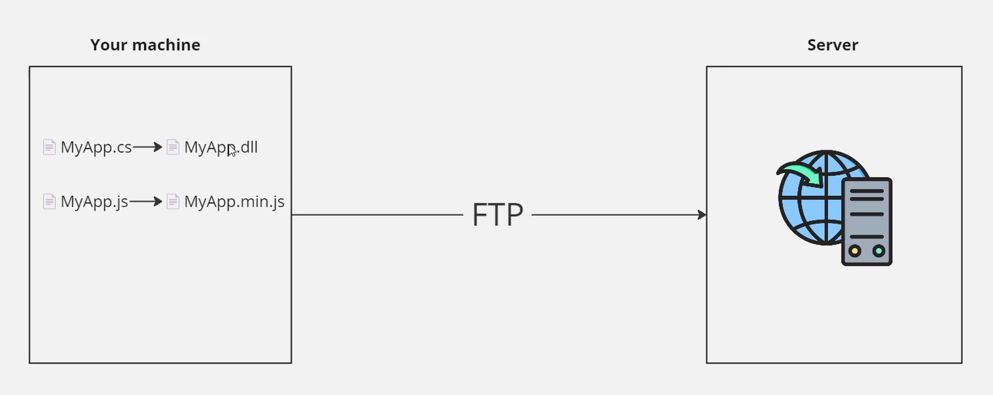
Before CI/CD

Slide 57
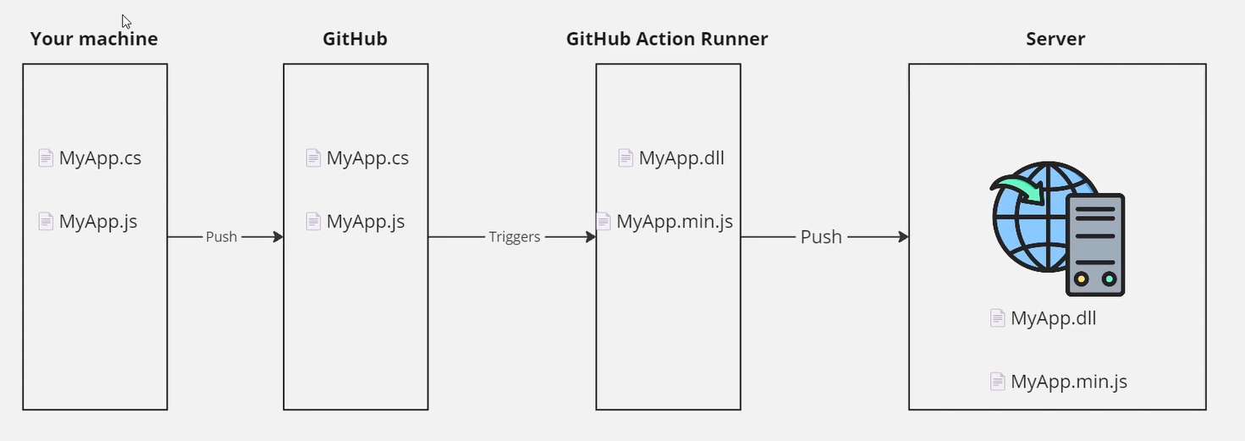
After CI/CD

Slide 58
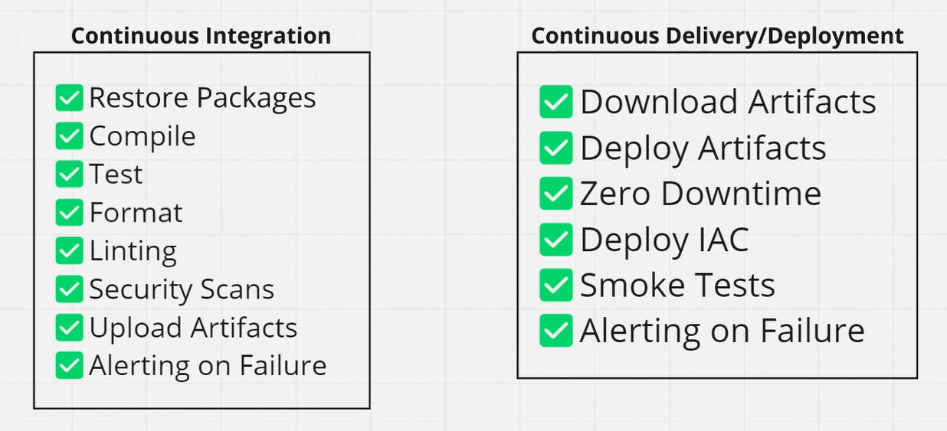
What’s in a Pipeline?

Slide 59
Questions?

Slide 60
GitHub Actions

Slide 61
What is GitHub Actions?
Thing doer on a trigger
Trigger could be PR, push to main branch, open an issue, etc
Automatically build and deploys your application
Including the infrastructure (i.e. Bicep)

Slide 62

GitHub Actions Concepts
Workflows
Triggers
Jobs
Steps
Inputs
Secrets
scottsauber

Slide 63
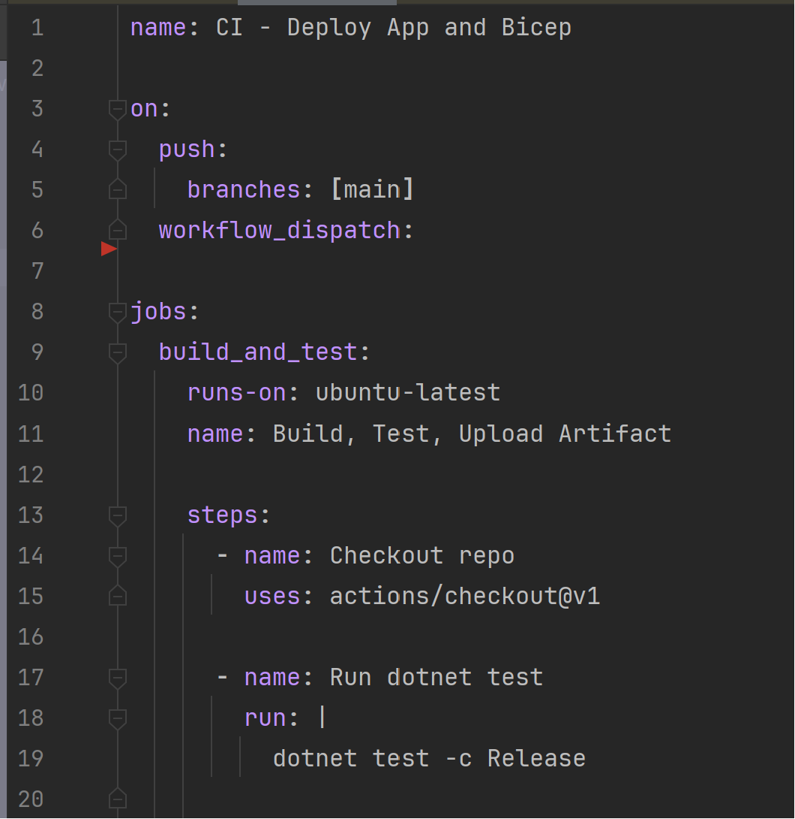
Example
scottsauber

Slide 64
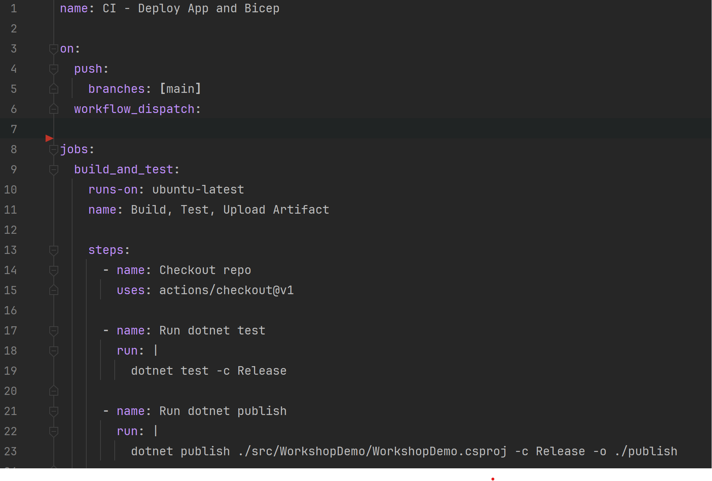
How do I reuse workflows?
scottsauber

Slide 65
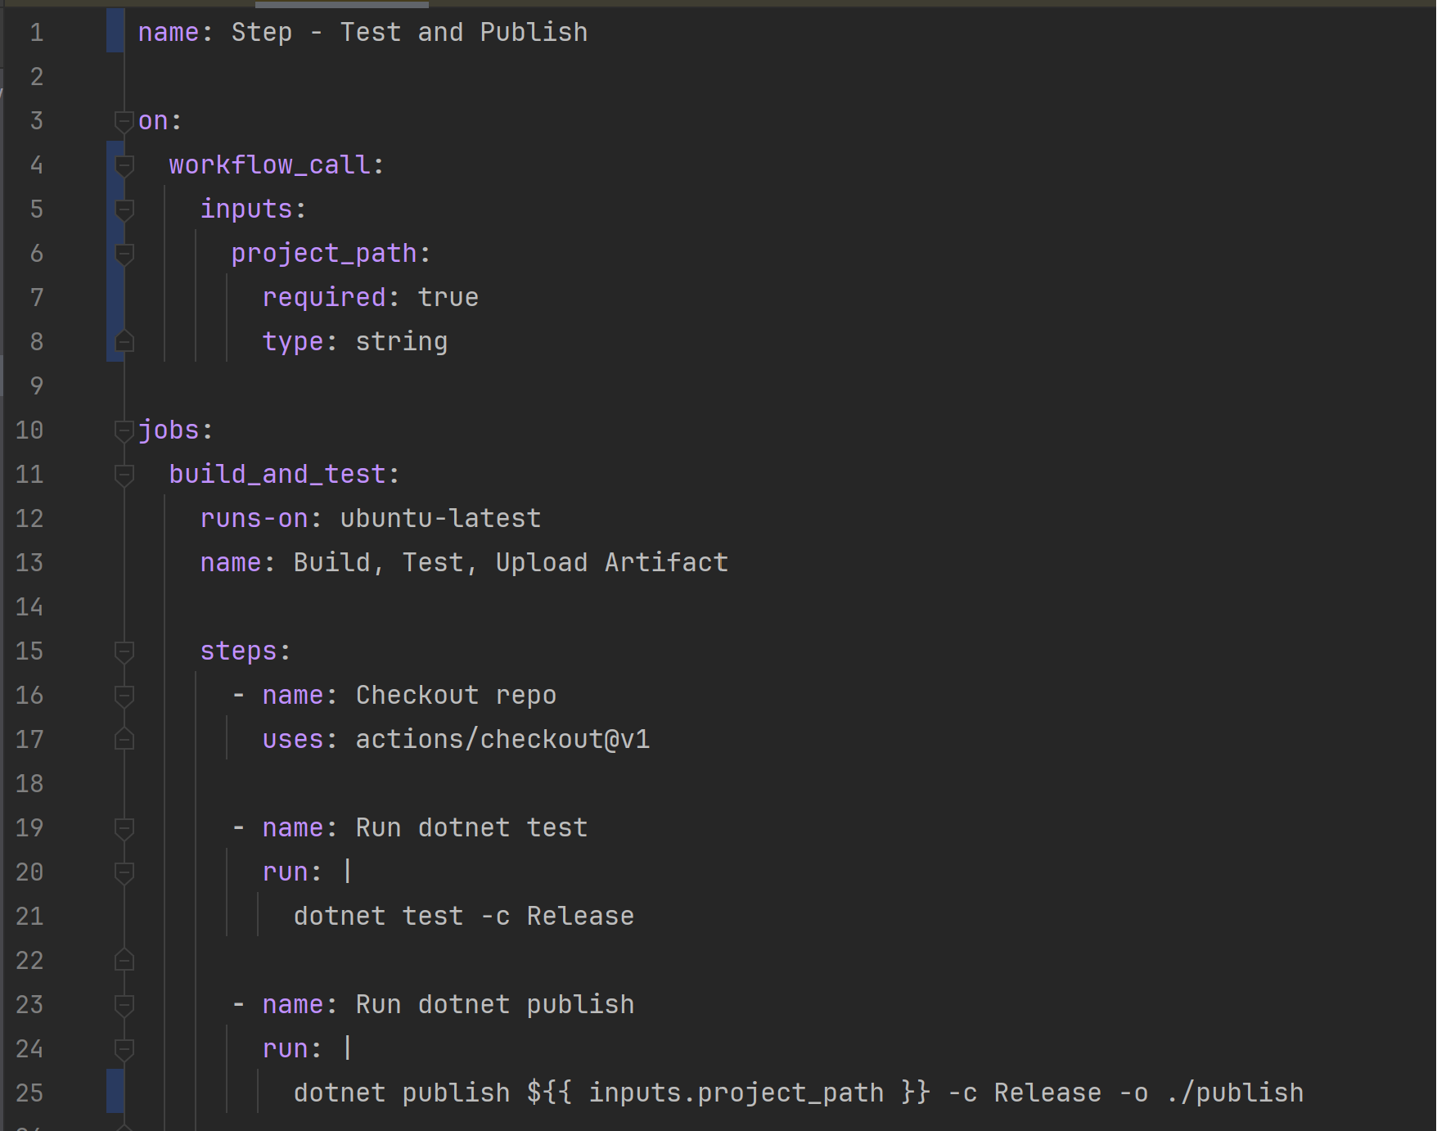
How do I reuse workflows?
scottsauber

Slide 66
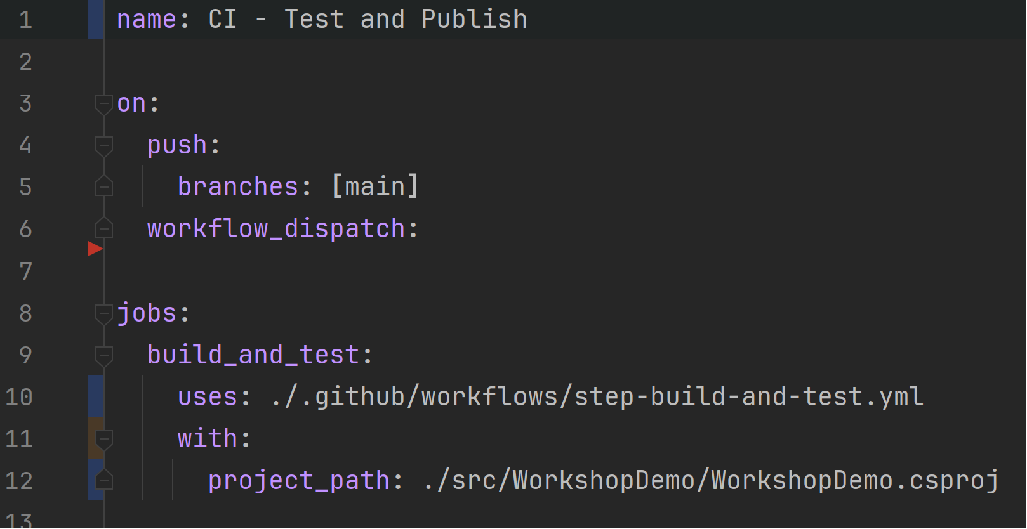
Consume reusable workflow
scottsauber

Slide 67
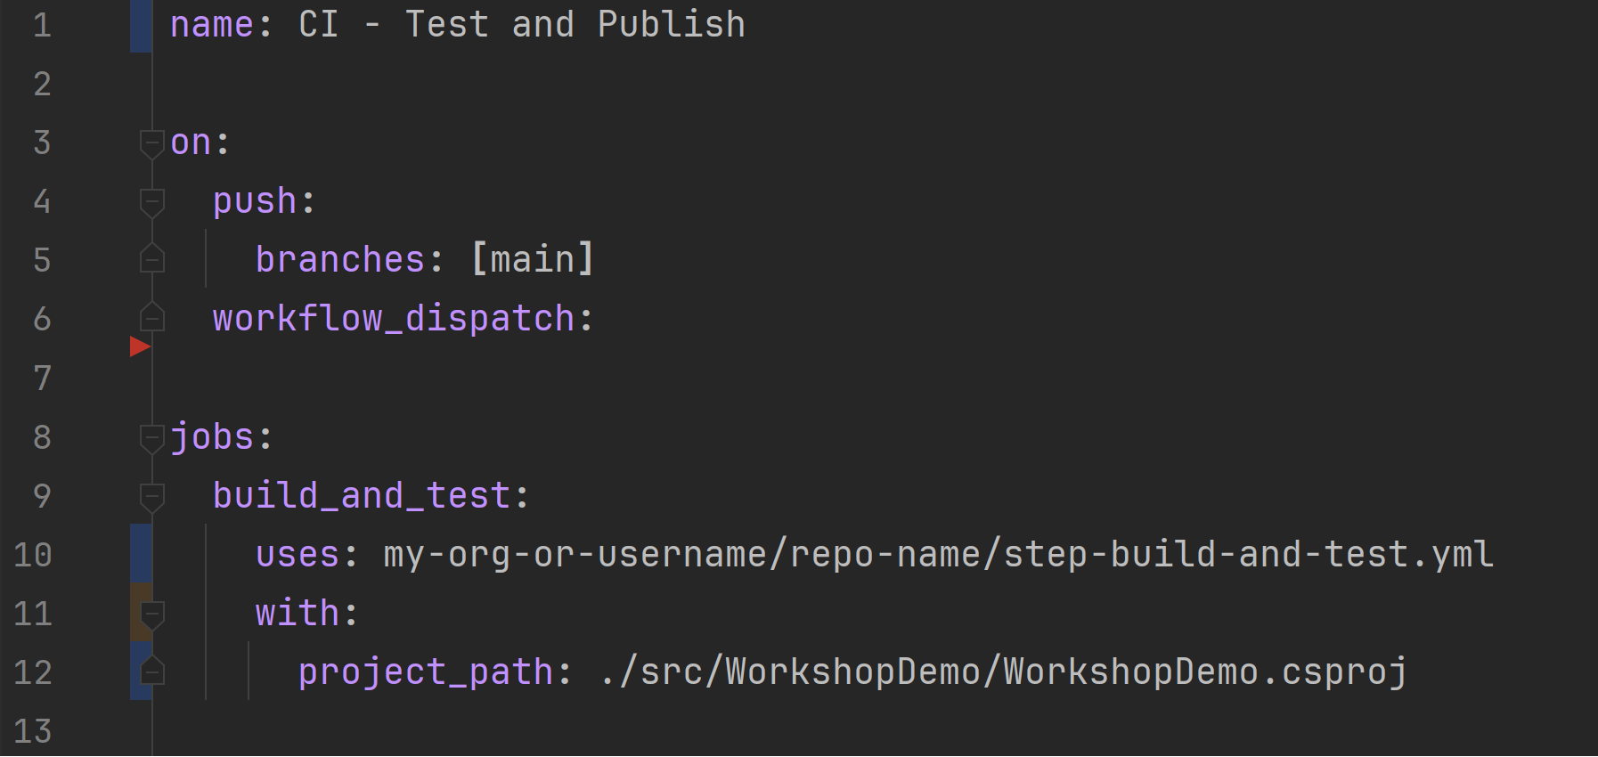
Consume from another repo
scottsauber

Slide 68
Live Demo

Slide 69
Questions?

Slide 70
Break then Hands On for 60 minutes Module 6: https://github.com/scottsauber/workshop-dotnet-azure-github-bicep
Notes:
TODO: Environments, Block from CD

Slide 71
Health Checks

Slide 72
What are Health Checks?
Health Checks check an app’s status
Might stop a rolling deployment
Might restart the app on failure
App Services allow configuring Health Check endpoint

Slide 73
What are Health Checks?
/api/healthz
Why z?
Z-pages from Google

Slide 74
What do you check?
Even “nothing” is useful. If it can’t get to the URL – the app didn’t boot
Can I connect to dependencies? (ie DB, APIs, Secret Store, etc)
Note: be careful here – if your DB goes down/blips, do you want your app to restart?

Slide 75
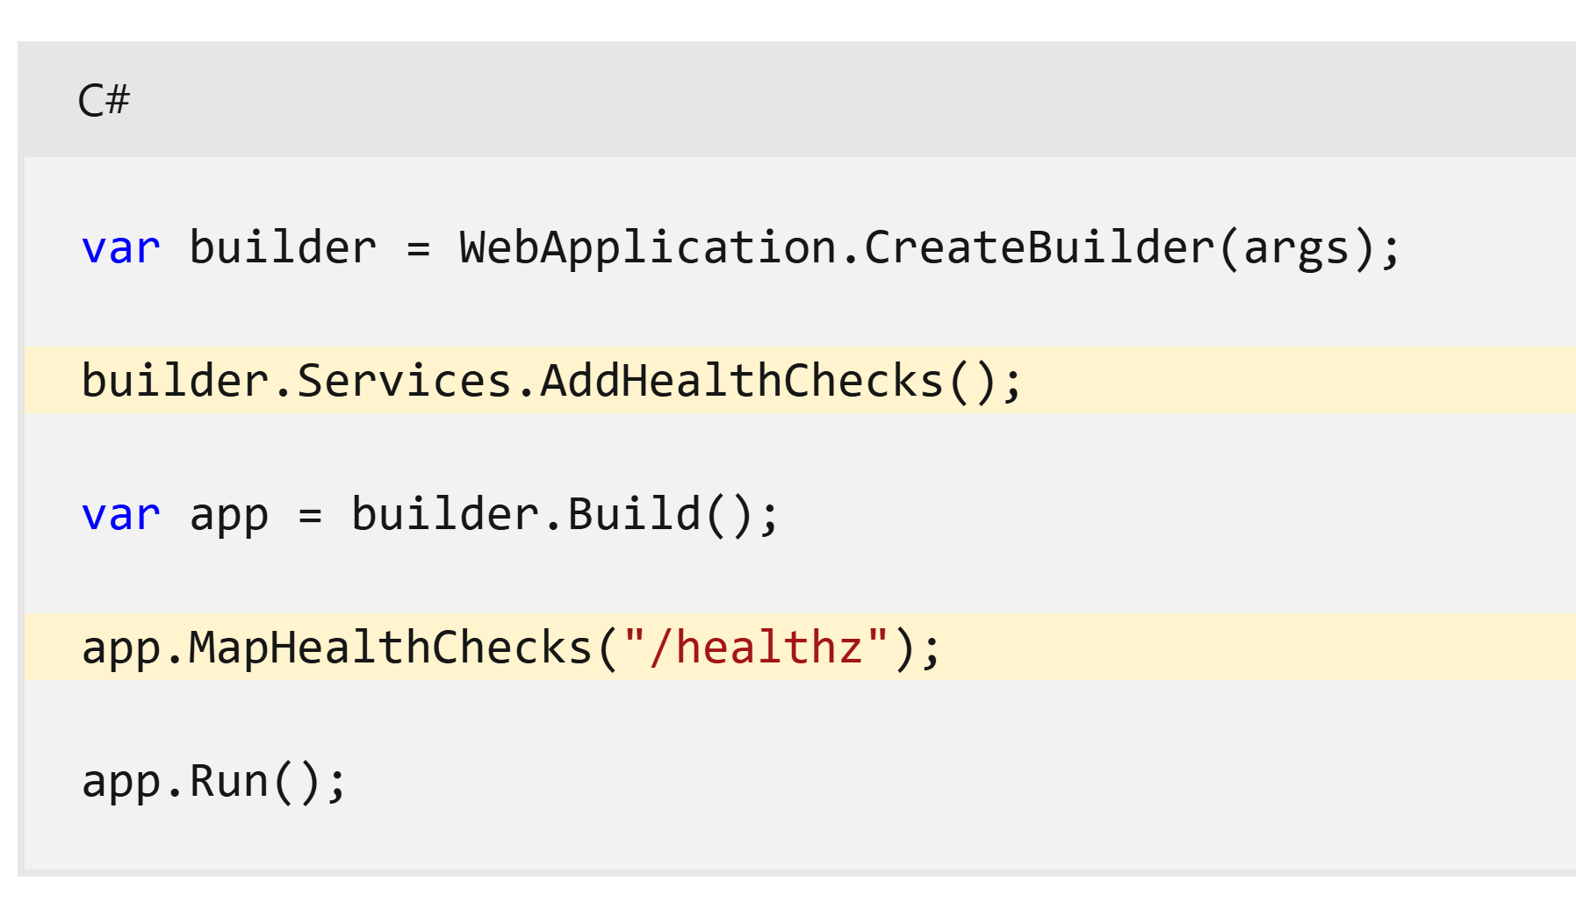

Slide 76
Questions?

Slide 77
Hands On for 15 minutes Module 8: https://github.com/scottsauber/workshop-dotnet-azure-github-bicep

Slide 78

Azure Key Vault

Slide 79
What is Azure Key Vault
Secret Store for Azure
Don’t store secrets in Version Control
Traceability
Rotate Secrets
$0.03 per 10K requests

Slide 80
Best Practices
Separate Key Vault per app per env
1 app * 3 envs = 3 key vaults
2 apps * 3 envs = 6 key vaults
Don’t leak keys across envs or apps
Naming: kv-<appname>-<environment>
ie kv-myapp-dev

Slide 81
.NET Integration
Plugs into IConfiguration
Loads keys on app boot (saves $ and more performant)
Azure.Security.KeyVault.Secrets
builder.Configuration.AddAzureKeyVault(“url”);

Slide 82
Managed Identities
Essentially the user (Service Principal) a service (ie App Service) runs as
Allows you to say “this App Service can talk to this Key Vault/DB/etc”
Microsoft handles the credentials for you behind the scenes

Slide 83
Access Policies for Key Vault
Allows you to specify who can connect to Key Vault
Could be a group (ie Developers), user, or application
Applications usually just need Read not Write

Slide 84
Local Secret Management
Local dev often requires secrets
.NET User Secrets is incompatible with teams, especially large ones
Everyone has their own file on their machine
Then secrets get shared around when they’re added/updated
Recommendation: use Key Vault even for local

Slide 85
Key Vault for Local
When someone adds/updates/deletes a secret, everyone gets it
Very team friendly
Only downside – heartbeat to an Azure service
In practice – rarely a problem

Slide 86
Live Demo

Slide 87
Questions?

Slide 88
Hands On for 30 minutes Module 9: https://github.com/scottsauber/workshop-dotnet-azure-github-bicep

Slide 89
DefaultAzureCredential

Slide 90
What is DefaultAzureCredential?
Azure services need to be authenticated to
There are lots of ways to do this – CLI, Environment Variables, ManagedIdentity, etc
DefaultAzureCredential tries all these for you until one works

Slide 91
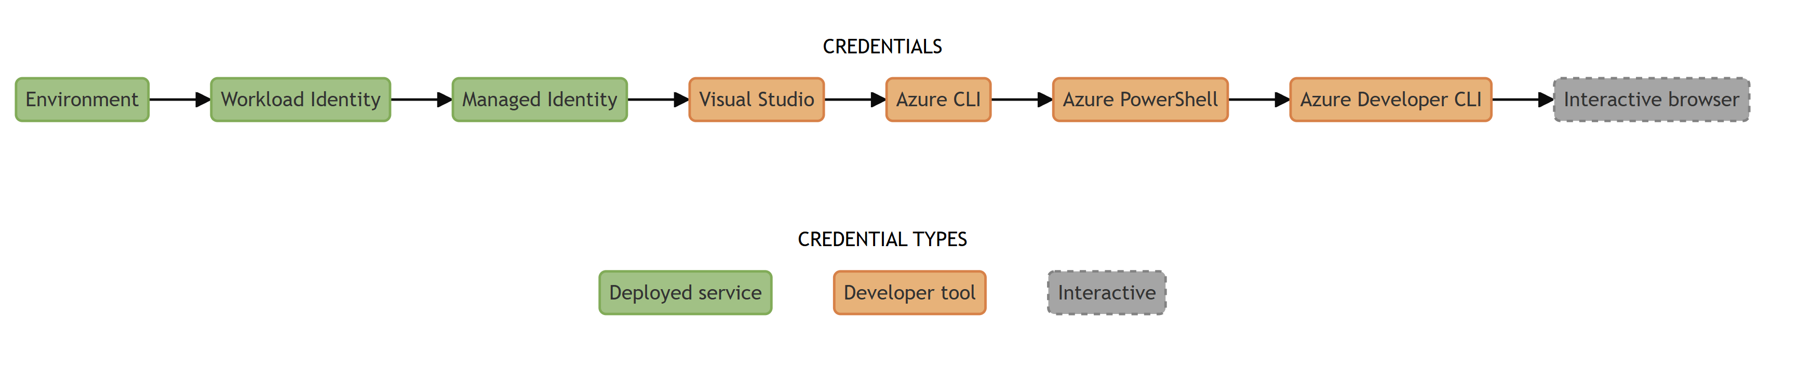
What order does it try?

Slide 92
Which ones do we use?

Slide 93
What’s the problem?
Often need 1-2 ways of authing
Local dev + deployed envs
In our case, Azure CLI (Local) and Managed Identity (Dev + Prod)
All other tries waste time
I’ve seen 10+ seconds saved doing what I’m about to do

Slide 94
Solution
DefaultAzureCredential has “Excludes”
ChainedTokenCredential
if local => CLI, else => ManagedIdentity
Notes:
Show DefaultAzureCredential – do a Stopwatch Start, Stopwatch Stop to illustrate DefaultAzureCredential with no settings and one with DefaultAzureCredentials(new DefaultAzureCredentialOptions{ Exclude // }

Slide 95
Live Demo

Slide 96
Questions?

Slide 97
Break?

Slide 98

Azure Log Analytics

Slide 99
What is Log Analytics?
Part of Azure Monitor - observability platform
Store Logs in central spot
Not in Log Stream
Query logs
SQL like syntax
Alert based on logs

Slide 100
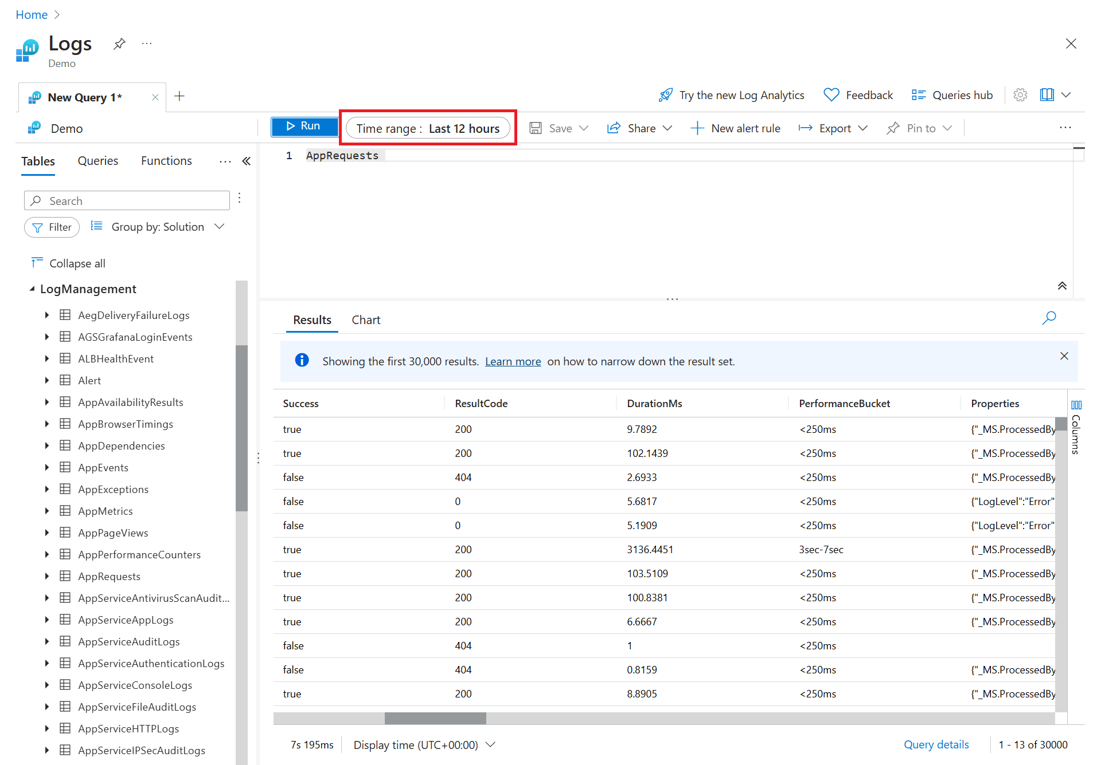

Slide 101
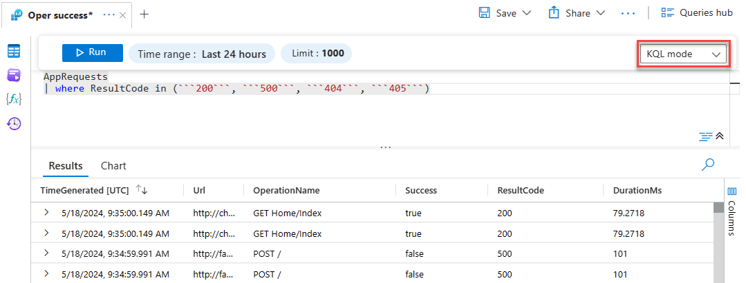

Slide 102
Questions?

Slide 103

Azure App Insights

Slide 104
What is Application Insights?
Part of Azure Monitor
Metrics
Traces
Application Maps
Diagnose Performance Issues

Slide 105
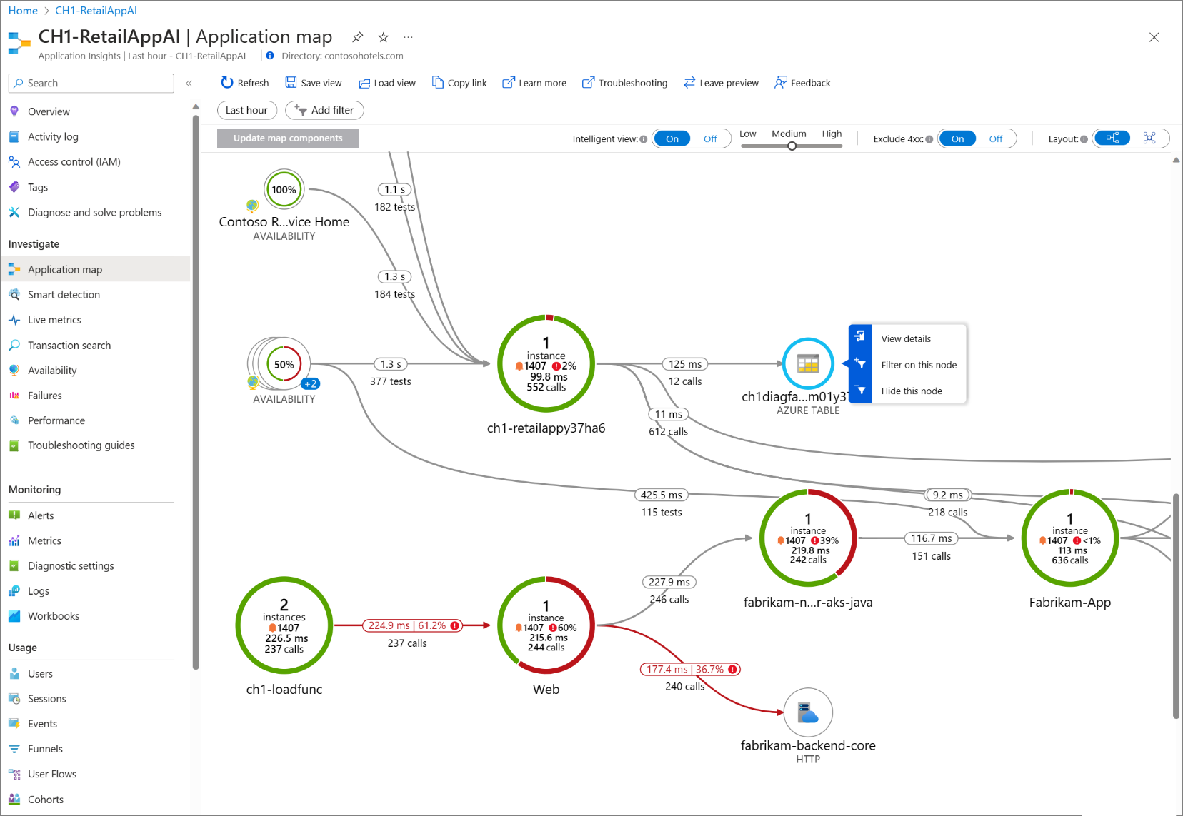

Slide 106
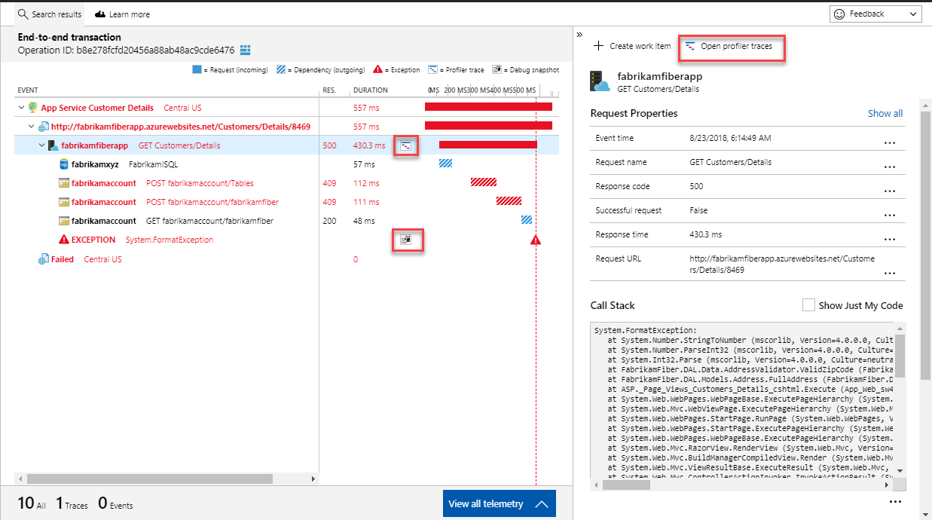

Slide 107
Questions?

Slide 108
Live Demo
Notes:
Show LogAnalytics
Query for ApplicationTraces
Query on custom properties
Show Application Insights

Slide 109
Hands On for 30 minutes Module 13: https://github.com/scottsauber/workshop-dotnet-azure-github-bicep

Slide 110
Takeaways
How to leverage Azure
How to integrate Azure with .NET
Why IAC is useful and how Bicep works
How GitHub Actions fits into CI/CD Pipelines
Some takeaway tips and tricks, even if you had prior experience with some of this

Slide 111
Resources
This slide deck
https://github.com/scottsauber/workshop-dotnet-azure-github-bicep
“final” branch has the final state of things

Slide 112
Live360 things to know
5:45 – 6:15 – Live360! First Timers Guide with Phil Japiske in
6:30 – 8:00 – Mix + Mingle Upstairs Patio HardRock Café City Walk

Slide 113
Any other Questions? ssauber@leantechniques.com @scottsauber on Twitter @scottsauber.com on Bluesky

Slide 114

Session Survey
Your feedback is very important to us
Please take a moment to complete the session survey found in the mobile app
Use the QR code or search for “Converge360 Events” in your app store
Find this session on the Agenda tab
Click “Session Evaluation”
Thank you!

Slide 115
THANK YOU!

Slide 116
If we have time…

Slide 117
Bonus: GitHub Environments
GitHub natively has the concept of Environments
These environments can have secrets
You can also set up Protection Rules on environments
Let’s refactor our code to use Environments!

Slide 118
Bonus PR Checks for Infra
When you change some Bicep it’d be nice to know what it’s going to do
--whatif for PR’s
Have the –whatif comment back on the PR what it’s going to do
Example

Slide 119
Bonus PR Checks for Infra
Checkov security scanner
Tells you if something is misconfigured
ie TLS 1.2 is not the minimum TLS setting for an App Service
Public Storage Accounts

Slide 120
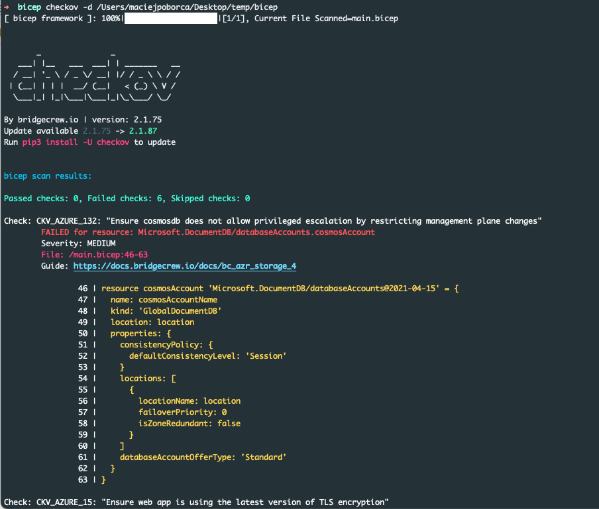

Slide 121
THANK YOU! (for real this time)

